Slide 1
Workshop #3:
Having Conversations About Medications With Health Care Providers
[Insert Facilitator’s Information Here]
Logo of Organization(s) Here

Slide 2
Acknowledgements
The development of this workshop series has been supported by The Centre for Aging and Brain Health Innovation (CABHI) and Centres for Learning, Research and Innovation in Long-Term Care (CLRI) at Bruyère
Content was originally developed and reviewed by:
  Pharmacists with the Bruyère Deprescribing Research Team: Pam Howell, Lisa Richardson and Barbara Farrell
  Research co-investigators: James Conklin and Lalitha Raman-Wilms
  Community advisory member: Kathryn Mulder

Slide 3
Overview of the series
Overall goals:
  Share information and experiences with
‘polypharmacy’, ‘medication management’ and ‘deprescribing’
  Share ideas on how to find and use the right medication information
  Help you have useful conversations with health care providers about medications
81

Slide 4
Rules of engagement
Confidentiality and privacy
Equal opportunities for sharing
Respectful conduct

Slide 5
What we have done so far:
Workshop #1:
Polypharmacy
Good medication management
Deprescribing
Workshop #2:
Keeping track of a medication history
Using reliable medication resources for information
82

Slide 6
Today’s objectives
You will be able to:
Identify questions you have about medications
Explain the idea of shared decision making as part of useful medication conversations
Play an important role in managing and making decisions about medications
83

Slide 7
How will we do this?
Review homework from Workshop #2
Share ideas on how to have useful conversations about medications with health care providers
Watch or participate in a role-playing exercise
Make a commitment plan to clear up one of your most important medication questions
84

Slide 8
Homework discussion
After Workshop #2, we asked you to try and fill in any remaining gaps in the medication chart
What resources did you use?
What resources could you have used?
85

Slide 9
Homework discussion
Based on all the medication information you now have:
Do you feel the need to have a medication conversation with a health care provider? Why or why not?
Why do you want to have this conversation?
Who would you have this conversation with?
Is there anything that worries you about or might stop you from having this conversation?
86

Slide 10
Useful questions and when to ask them
87

Slide 11
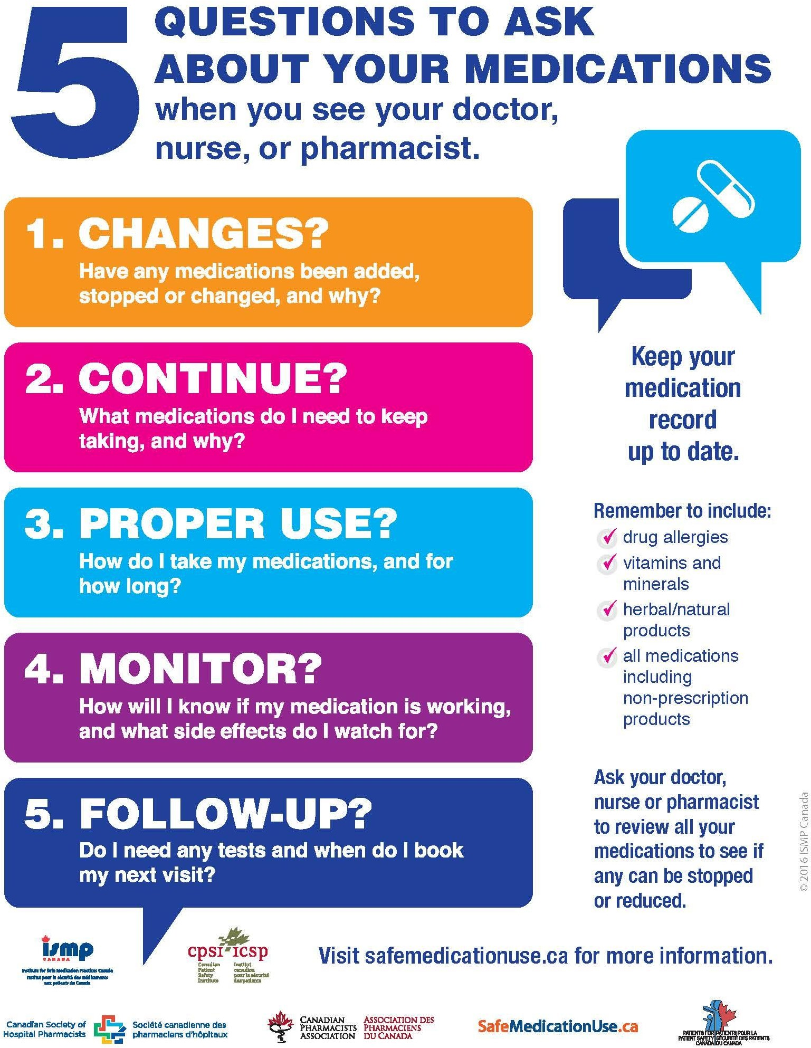
88

Slide 12
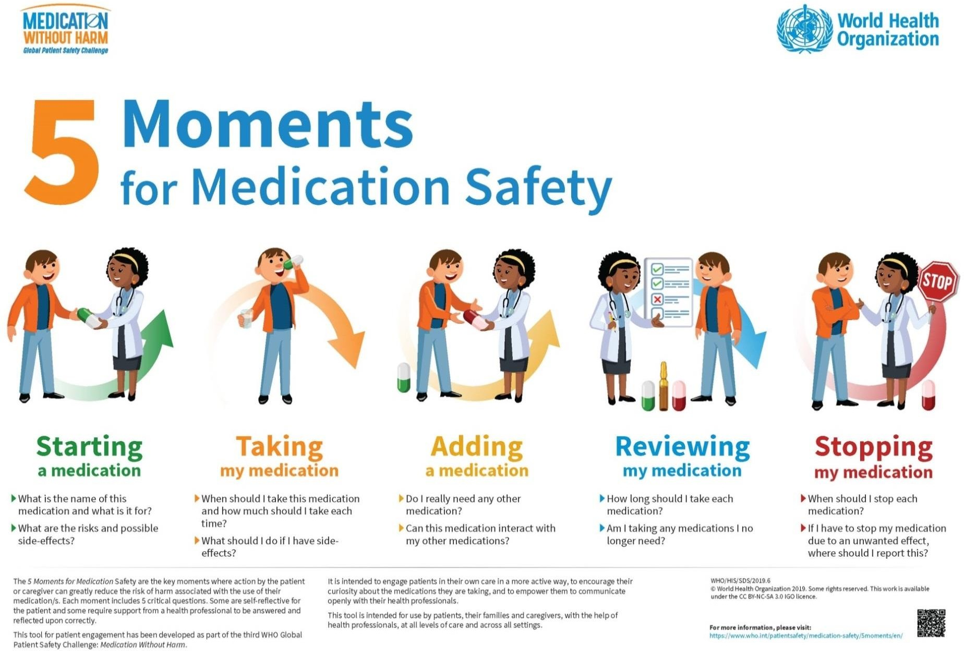
89

Slide 13
Additional moments for medication safety
At admission (and discharge) to hospital or long-term care
At regular medication reviews and annual care conferences (in long-term care)
When goals of care change (e.g. near end-of-life)
90

Slide 14
Now let’s talk about shared decision making
91

Slide 15

It’s about a two-way conversation
https://www.nia.nih.gov/health/effective-communication-caring-older-adults
92

Slide 16
Research has taught us…
Patients do better when they participate in their own care
Health care providers are more likely to consider deprescribing if the patient or caregiver bring it up
Making more information available to patients and their caregivers helps shared decision making with health care providers
93

Slide 17
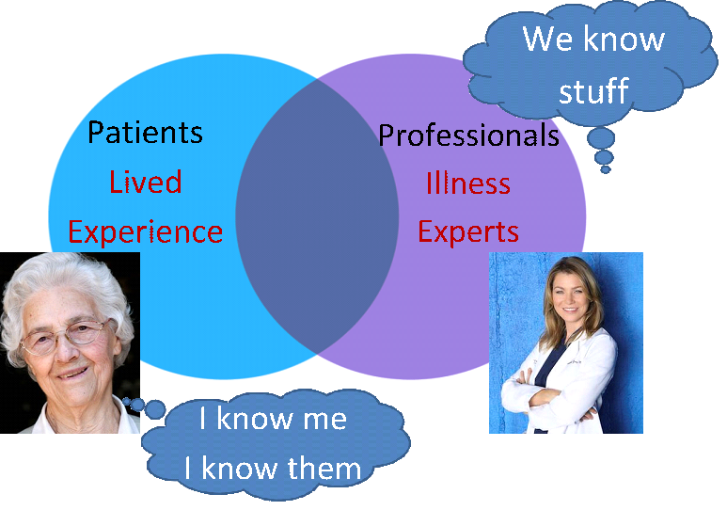
Collaborative care: the importance of shared expertise
94

Slide 18
The shared decision making process
Provide information about your medication experience (or that of the person for whom you care) (don’t assume the health care provider knows)
Ask for information about options (e.g. reducing or stopping medication, alternatives to medication or safer medications)
Describe personal goals and preferences about treatment options, including medications
Make a decision (If you disagree or change your mind, tell them)
95

Slide 19
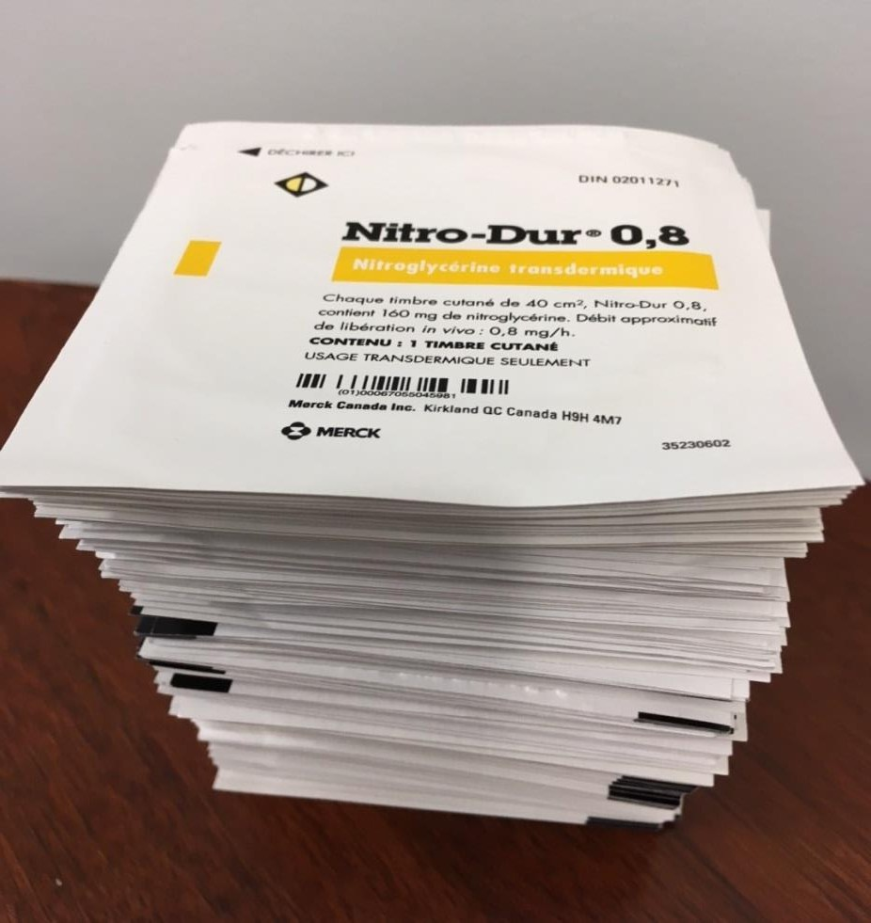
What might prevent you from doing this with a health care provider?
96

Slide 20
What might prevent you from having a shared decision making conversation
with a health care provider?
97

Slide 21


What questions do I need to ask to participate in shared decision making?
Questions to ask your health care provider
What are the different options available? Are there any non‐drug options?
What are the risks of each option?
What are the benefits of each option?
Questions to ask yourself
What is important to me or the person I care for?
Am I ready to make a decision?
98

Slide 22
What are alternatives to medications?
Depending on the situation, you can consider alternatives to medications such as:
  Exercise
  Physiotherapy
  Pet therapy
  Music therapy
  Changing the environment (e.g. temperature, dust)
Ask a health care provider if there are any non-drug options available
99

Slide 23














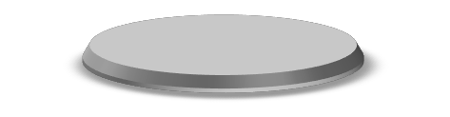
Benefit
Risk
More medical conditions and medications
Evidence for ongoing reason for use
(diagnosis, risk)
Frailty
Age-related changes
Evidence for effectiveness
Known side effect(s) or
risk of side effect(s)
Risks and Benefits of Taking Medications in the Long Term
100

Slide 24

Why do you think deprescribing a medication might be a challenge?
101

Slide 25


What questions do I need to ask when considering risks and benefits of
deprescribing?
Pros
Fewer drugs –
reduced pill burden
Less potential side‐ effects
Less costly
More patient‐ centered care
Cons
Withdrawal symptoms
Worsening of underlying disease/condition
Anxiety over what could happen
102

Slide 26
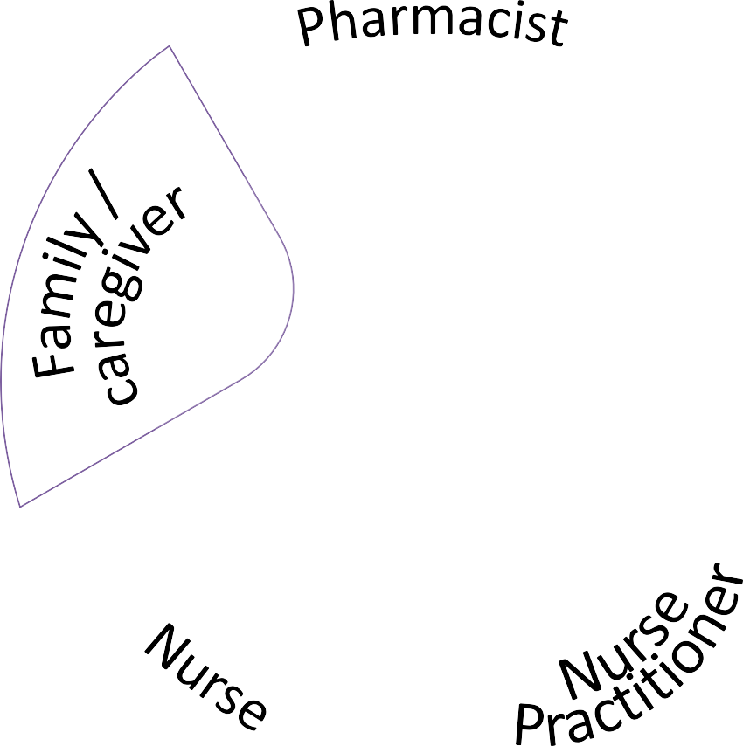


Who should you be having these conversations with?
Patient
103

Slide 27
So you are thinking about having a discussion with a health care provider
about medications…
What might get in your way?
Does anyone have ideas of possible solutions?
What things should you do to be prepared?
104

Slide 28
What could a medication conversation look like?
LET’S SEE ONE IN ACTION
YouTube: "Talking About Your Medications" - Example Shared Decision Making Conversation
https://youtu.be/X8HUxu3ASX0
105

Slide 29
LET’S REVIEW
What were your general impressions?
Have you ever had a conversation like this?
What did you learn from this example?
Do you think you could participate in a shared decision making conversation?
106

Slide 30
How can we help you get ready for your conversation?
Making a commitment plan
107

Slide 31
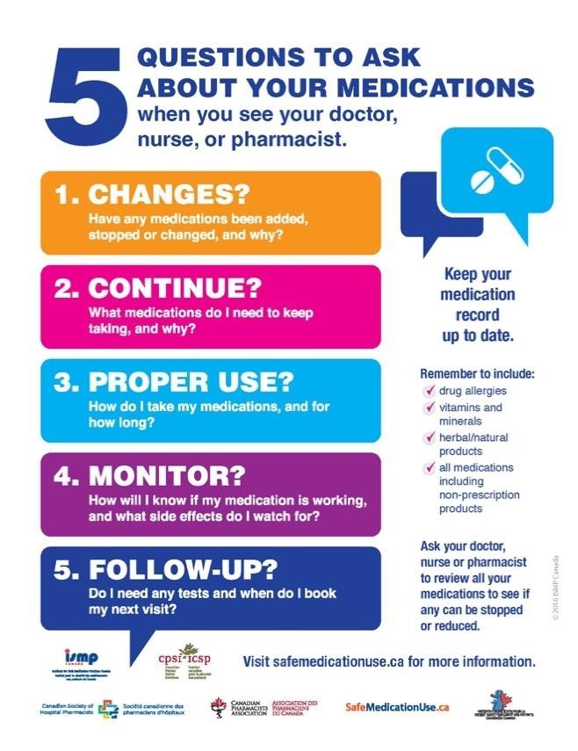

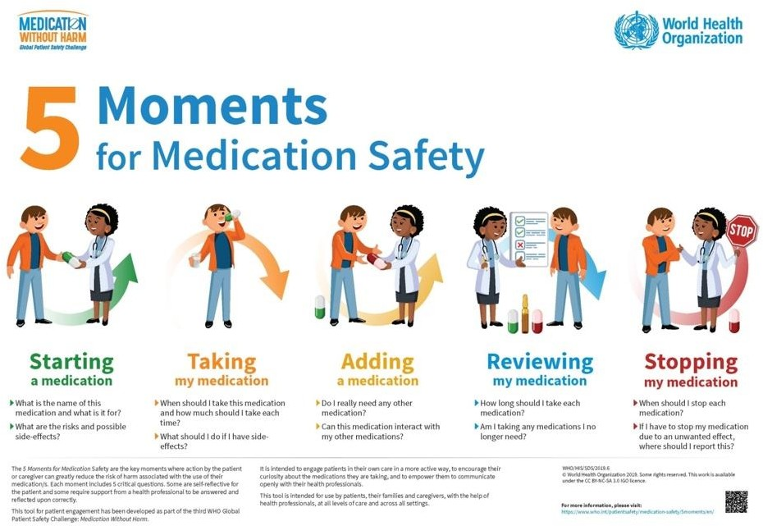
Overview of the resources listed in your workbook for this session
109

Slide 32
This journey was about:
Sharing information and experiences with
‘polypharmacy’, ‘medication management’ and ‘deprescribing’
Sharing ideas about how to find the right medication information and keep track of it
Helping you have useful conversations with a health care provider about medications
110

Slide 33
Wrap‐up
Questions?
Contact us:
  If you have any questions or concerns
  If you want an electronic copy of the medication chart or resource list
111

