Slide 1
Workshop #2:
Getting Reliable Medication Information
[Insert Facilitator’s Information Here]
[Logo of Organization(s) Here]

Slide 2
Acknowledgements
The development of this workshop series has been supported by The Centre for Aging and Brain Health Innovation (CABHI) and Centres for Learning, Research and Innovation in Long-Term Care (CLRI) at Bruyère
Content was originally developed and reviewed by:
  Pharmacists with the Bruyère Deprescribing Research Team: Pam Howell, Lisa Richardson and Barbara Farrell
  Research co-investigators: James Conklin and Lalitha Raman-Wilms
  Community advisory member: Kathryn Mulder

Slide 3
Overview of the series
Overall goals:
  Share information and experiences with
‘polypharmacy’, ‘medication management’ and ‘deprescribing’
  Share ideas on how to find and use the right medication information
  Help you have useful conversations with health care providers about medications

Slide 4
Rules of engagement
Confidentiality and privacy
Equal opportunities for sharing
Respectful conduct

Slide 5
What we have done so far:
Workshop #1:
Polypharmacy
Good medication management
Deprescribing

Slide 6
Today’s objectives
You will be able to:
Describe what you need to know about medications and why it is important
Keep track of this information in a way that is organized and easy to use
Use reliable medication resources if you have questions

Slide 7
How will we do this?
Review the pieces for a medication history and why they are important
Share what you thought was useful about completing the homework
Share challenges you had in completing the homework
Share ideas on where and how to find information for a good medication history

Slide 8
Reflection Worksheet #1 – Important Pieces of Medication History and Experience Information
Fill out individual worksheets
Worksheets found on pages 54-56 of Participant Workbook

Slide 9
Remember what doctors have told us
It is challenging for them to keep up to date
records about a patient’s medications
Information that is important to keep track of and share with them includes:
  The reason for taking the medication
  How long the medication has been taken
  General feelings about taking the medication

Slide 10
Homework discussion
What details did you find hard to fill out on the medication chart? Why?
Where did you get the information to help fill out the medication chart?
What did you like about the way the medication chart is organized?
What did you NOT like about the way the medication chart is organized?
Do you have another way of keeping track of this kind of medication information?

Slide 11
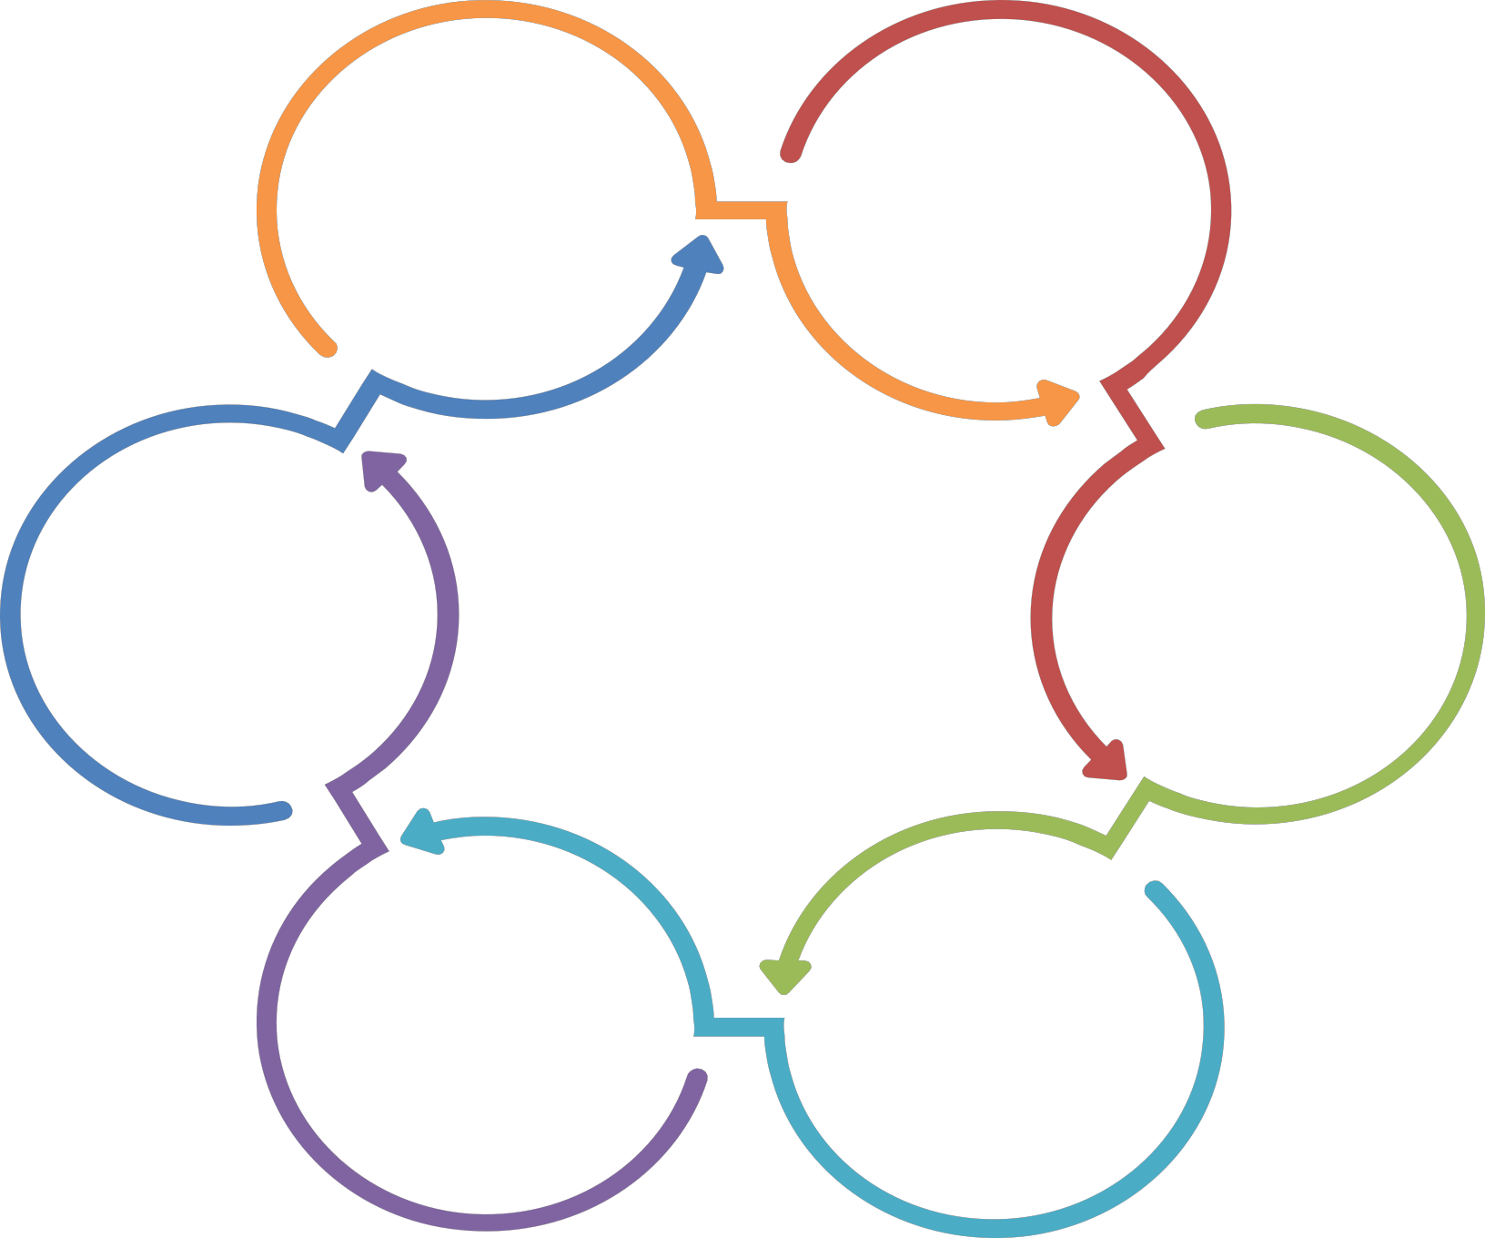


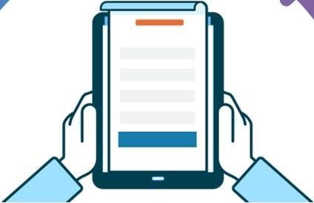



Medication
Resources
All icons are made and used courtesy of Flaticon.com (https://www.flaticon.com ) under Creative Commons license CC 3.0 BY.
59

Slide 12
What do we mean by “reliable medication resources”?
Anywhere or anyone trusted to give correct
and up‐to‐date medication information
General tips:
  Is it written by or an in-person consultation with a health professional (e.g. doctor, nurse,
pharmacist)?
  Is the information current?
  Is the information the same if you check another resource?

Slide 13
Medication information resources: Online
Information accessible on the Internet
These sources can give you information on:
  Medical conditions, reason for use, side effects, and drug interactions
Reliable sites:
  Usually end in .org, .gov or .edu
  Do not have a lot of advertisements in them (they are not trying to make money)
  Do not make claims that a product can treat all people or any sickness
  Often have an “About Us” or “Contact” page that tells
you who wrote the information

Slide 14
Wikipedia
An online encyclopedia
Information is not always trustworthy because:
  You do not know who wrote the information (are they an expert?)
  You do not know who reviewed the information (are they an expert?)
  May not include new research or information
  Information can be difficult to understand

Slide 15
Medication information resources: People
Who?
  Health care providers include your community pharmacist, doctor, nurse practitioner, public health nurse
  Telehealth Ontario (Toll‐free: 1‐866‐797‐0000)
  Be careful of information from your family, friends, or neighbours (are they an expert?)
Health care providers can give you information on any of the details in the medication chart

Slide 16
Beware: Television, radio shows and commercials
Often exaggerated information that is not always supported by quality
evidence
Always talk with your health care provider first (even if it is a doctor or pharmacist sharing the information)

Slide 17
Great sources of medication information
Your health care provider (e.g. physician, pharmacist, nurse)
Medline Plus (www.medlineplus.gov)

Slide 18
Let’s practice!

Slide 19
Let’s discuss the information
Was it easy to find?
Was it easy to understand?
Was the information the same in all the resources?
Are there any questions you have about this information?
Where would you go now to find the answers to your questions?
How would you use this information?

Slide 20
Homework part 1: Adding to a medication chart
Use reliable resources to fill in missing information, add more details about the medication history, and to learn more about the medications

Slide 21
Homework part 2: Reflections
Fill out the reflections worksheet that we can discuss at the next workshop
Based on all the medication information you now have:
  Do you feel the need to have a medication conversation with a health care provider? Why or why not?
  Why do you want to have this conversation?
  Who would you have this conversation with?
  Is there anything that worries you about or might stop you from having this conversation?

Slide 22
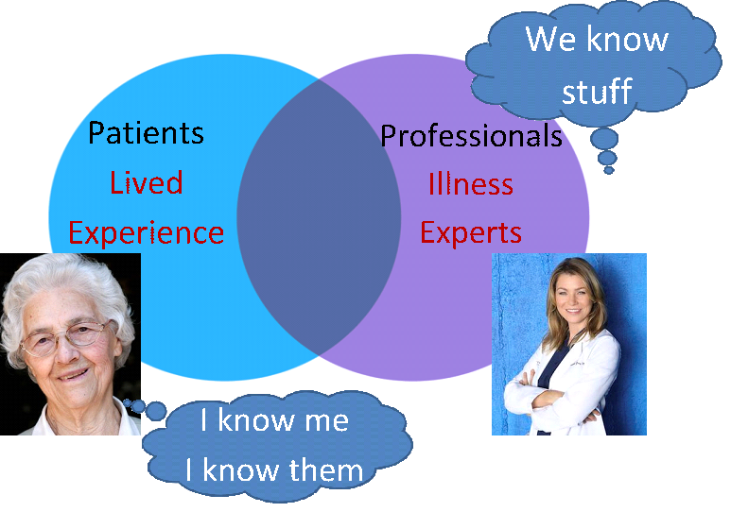
Information expert: where does your opinion fit (as a patient and/or caregiver)?

Slide 23
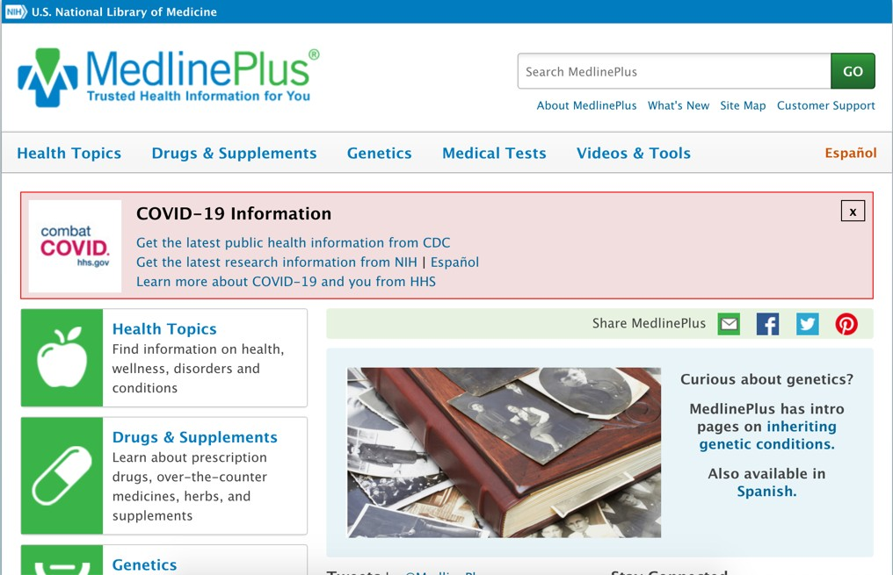
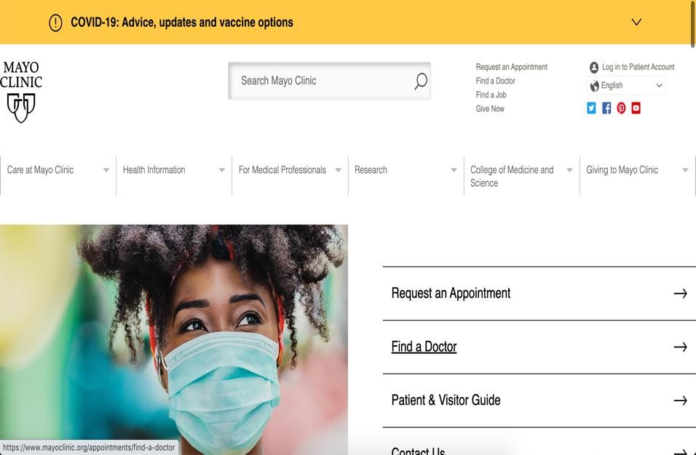
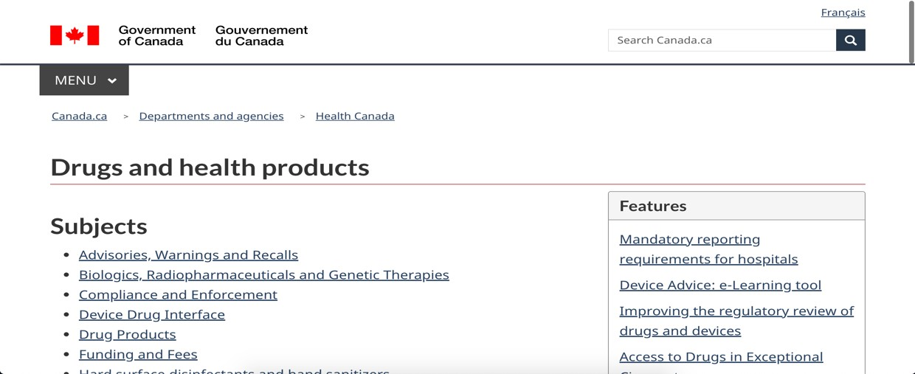
Overview of the resources listed in your workbook for this session

Slide 24
What we’ll do at the next workshop
Review the homework
Share ideas on how to have useful conversations about medications with health care providers

Slide 25
Wrap‐up
Questions?
Next session:
Contact us:
  If you have any questions or concerns
  If you want an electronic copy of the medication chart or resource list

