Slide 1
Workshop #1:
Talking About Medications
[Insert Facilitator’s Information Here]
[Logo of Organization(s) Here]

Slide 2
Acknowledgements
The development of this workshop series has been supported by The Centre for Aging and Brain Health Innovation (CABHI) and Centres for Learning, Research and Innovation in Long-Term Care (CLRI) at Bruyère
Content was originally developed and reviewed by:
  Pharmacists with the Bruyère Deprescribing Research Team: Pam Howell, Lisa Richardson and Barbara Farrell
  Research co-investigators: James Conklin and Lalitha Raman-Wilms
  Community advisory member: Kathryn Mulder

Slide 3
Overview of the series
Three 90-minute workshops with ‘homework’
Overall goals:
  Share information and experiences with
‘polypharmacy’, ‘medication management’ and ‘deprescribing’
  Share ideas on how to find and use the right medication information
  Help you have useful conversations with health care providers about medications

Slide 4
Rules of engagement
Confidentiality and privacy
Equal opportunities for sharing
Respectful conduct

Slide 5
Purpose of your workbook
A tool to help keep track of everything you learn during the workshops
It contains:
Copies of the slides for you to take notes
Worksheets to use during the workshop
Homework sheets
Information on useful resources

Slide 6
Today’s objectives
You will be able to:
Describe the problems of polypharmacy among older adults
Describe how polypharmacy is a problem for you
or the person for whom you are caring
Describe some of the benefits that can result from appropriate medication management
Explain how deprescribing is part of good prescribing and ideal medication management

Slide 7

Are there questions?

Slide 8

Getting to know you and what you know
In 1 minute, introduce yourself and tell the group what you think about the following question
When I hear the term
‘polypharmacy’, I think…

Slide 9
Polypharmacy
What does it mean?
What does it look like?
Why should you be concerned about it?

Slide 10

Medications can:
Treat symptoms
Help medical conditions from getting worse
Reduce the risk of getting a new medical condition

Slide 11

Polypharmacy: Definition
The use of more medications than are needed or for which harm outweighs benefit
Particular risk for older people because they respond to drugs differently, are often frail, and are not typically represented in research

Slide 12
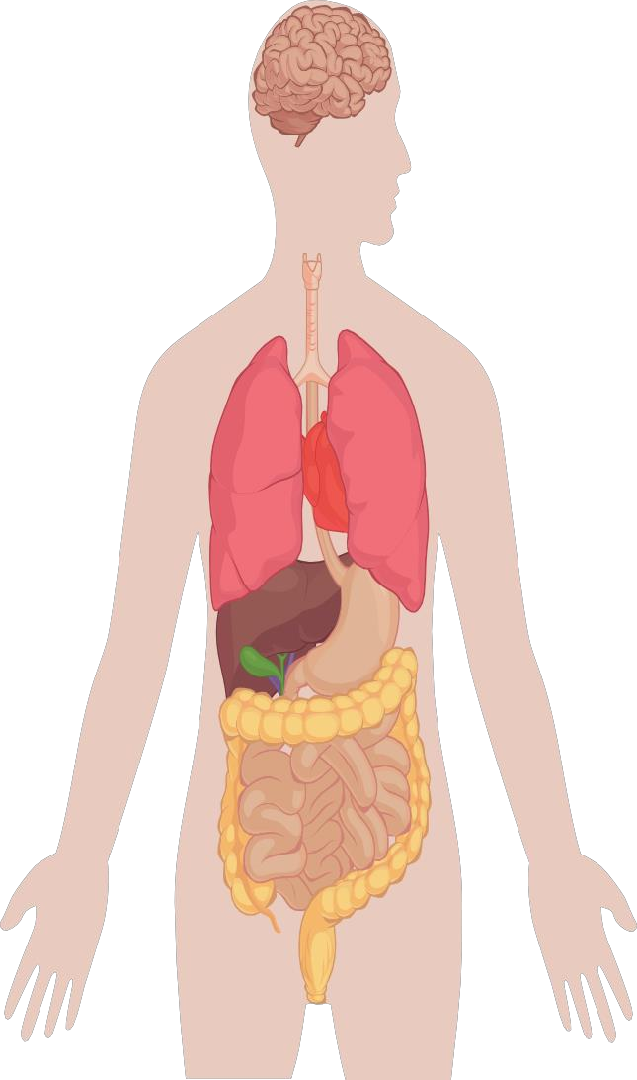
As we get older
The brain becomes more sensitive to drug effects
Some medications stay in our body longer because we have less muscle and more body fat
Our liver and kidneys do not process medications as efficiently as when we were younger
Our body contains less water and medications can become more concentrated
New symptoms could be due to the body’s changed response to medications

Slide 13
Polypharmacy can lead to problems
Drug interactions or side effects
Trouble taking medications as directed
Body not moving as well as it should Mind not working as well as it should
Falling and getting a fracture Being admitted to the hospital
Increases the risk of

Slide 14

And can eventually make someone
feel like this …

Slide 15
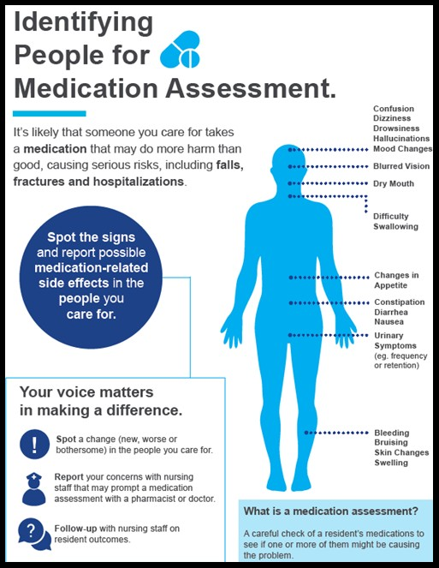
Recognizing symptoms in someone else

Slide 16
If we know polypharmacy is a problem, why does it still happen?
More medications available than ever before
People live longer (more diseases = more medications)
Guidelines often tell prescribers when to start drugs but not when to stop them
Increased hospital admissions (with many prescribers)
Fear of ‘rocking the boat’ by prescribers and patients
A culture of adding a medication before trying a non- drug solution (e.g. exercise, physiotherapy)
People not knowing about the risks of medications
Patients not knowing how to advocate for themselves

Slide 17
What can you do?

Slide 18
Reflection Worksheet #1 – Patient Experiences with Medication Management
Fill out individual worksheets from the perspective of a patient or as a caregiver
Worksheet found on page 22 of Participant Workbook

Slide 19
Group discussion
Do you know what medications you or the person you care for take?
Do you know the purpose of each medication?
How do you keep track of all the medications?
Who is involved in managing these medications?
How do you get information about medications?
What concerns do you have about the medications being used?
Do you feel polypharmacy applies to you or the person you care for?
23

Slide 20
Medication management: Definition
A system that supports your capacity to
Understand
Organize
Take
And monitor medications in a way that makes sure they are working well and not causing problems
24

Slide 21
Reflection Worksheet #2 – Medication Management Quiz
What do you think are the benefits of good medication management?
Good medication management can:
 | True? | False?
Reduce potential medication side‐effects
Reduce the possibility of drug interactions
Take up a lot of time and energy
Make it easier to take the right medications at the right time
Result in taking more medications than wanted
Help monitor if medications are working the way they should
25

Slide 22
What are the benefits of good medication management?
 | True? | False?
Reduce potential medication side‐effects | ✓
Reduce the possibility of drug interactions | ✓
Take up a lot of time and energy |  | ✓
Make it easier to take the right medications at the right time | ✓
Result in taking more medications than wanted |  | ✓
Help monitor if medications are working the way they should | ✓
26

Slide 23
Good medication management also includes deprescribing:
Deprescribing is the planned and supervised process of dose reduction or stopping of medication that may be causing harm or no longer providing benefit
The goal of deprescribing is to reduce medication burden and harm while maintaining or improving quality of life
Deprescribing is part of good prescribing – backing off when doses are too high or stopping medications that are no longer needed or may be causing harm
27

Slide 24
Why is deprescribing important and how can we make sure it gets addressed?
Good medication management involves making clear decisions about what to continue AND what to reduce or stop
Health care providers can help make decisions about deprescribing (reducing or stopping) when you share medication experiences
A good medication history is an important first step to communicating a medication experience
28

Slide 25
Doctors tell us…
It is challenging for them to keep up to date
records about a patient’s medications
Information that is important to keep track of and share with them includes:
  The reason for taking the medication
  How long the medication has been taken
  General feelings about taking the medication
29

Slide 26
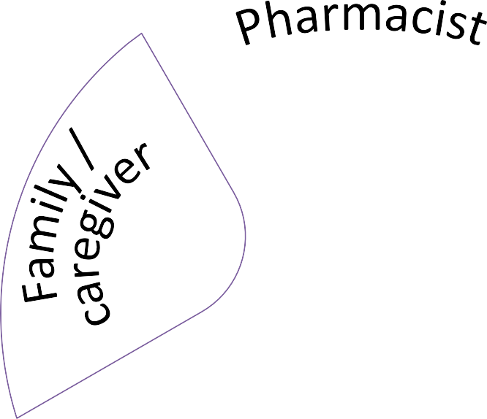




Conversations about deprescribing require communication
Patient
30

Slide 27
Tracking medication history and experience
Important pieces:
Medication name (e.g. prescriptions, eye drops, creams, over-the-counter, vitamins, herbals, etc.)
Both regular and ‘as-needed’
Reason for use
Directions and how it is taken
When it started and expected duration
Who prescribed it
The effect – both good (i.e. work as expected) and bad (i.e. side effects)
31

Slide 28
Tracking medication history and experience
Important pieces:
Changes in doses, when and reasons why
Medications that have been tried in the past but are no longer being taken and why (a side effect? didn’t work?)
Allergies
Intolerances (severe side effects)
Medications a health care provider has said not to use and why
32

Slide 29
What is considered a medication?
Prescription medications – such as antibiotics, blood pressure medications
Over the counter (OTC) products – such as allergy, cough and cold, headache, pain medications
Vitamins and minerals
Natural health products – herbals, homeopathic
Traditional medicines – ones that are specific to certain countries or cultures
Caffeine, alcohol, nicotine, cannabis
33

Slide 30
What is considered a medication?
Medications come in many forms:
Tablets
Capsules
Liquids
Eye/Ear drops
Inhalers/puffers
Nasal Sprays
Patches
Injections
Creams/ointments/ lotions/ gels
Suppositories
Vaginal inserts
34

Slide 31
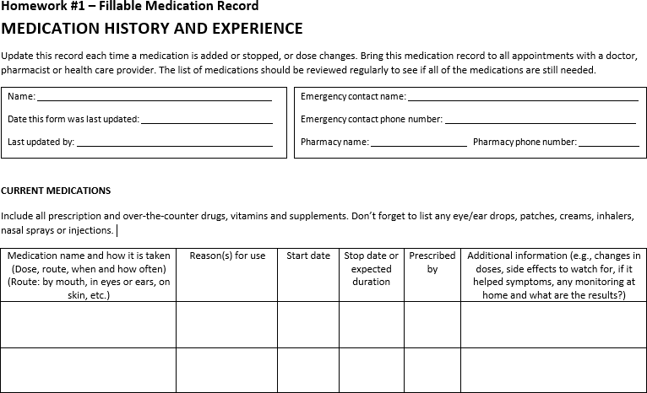
Homework part 1: Making a medication chart
35

Slide 32
Homework part 2: Reflections
Fill out the reflections worksheet that we can discuss at the next workshop
  What details did you find hard to fill out in the medication chart? Why?
  Where did you get the information to help fill out the medication chart?
  What did you like about the way the medication chart is organized?
  What did you NOT like about the way the medication chart is organized?
  Do you have another way of keeping track of this kind of medication information?
36

Slide 33

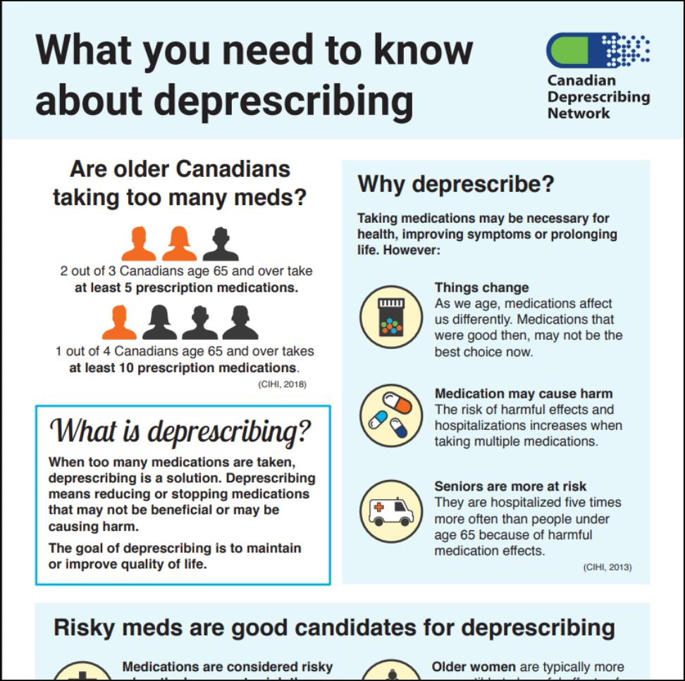

Overview of the resources listed in your workbook for this session
37

Slide 34
What we’ll do at the next workshop
Share challenges you had in completing the homework
Share ideas on where and how to find information for a good medication history
38

Slide 35
Wrap‐up
Questions?
Next session:
Contact us:
  If you have any questions or concerns
  If you want an electronic copy of the medication chart or resource list
39

